Slide 1
Introduction to Intel’s
Manufacturing Data for Assembly/Test
(view in slide show mode)
Notes:
1

Slide 2
Introduction to Intel’s Manufacturing Data
Canned Applications
Scripting / Statistics
Ad-hoc
Catalyst
Crystal
Ball
CATTS
MKC
ScriptHost,
JMP, Python, R, Excel
SQLPathFinder
Other Tools
SQL
Other. E.g., TCA
AEPT, EPROMS,
ASPIRE, SPEED
ATRMS, ULT…
MARS
ARIES
or
XEUS
OASys
15m
20m
15m
E.g.,
Equipment,
MT
WorkStream
E-Test &
Sort/Class
Testers
SPC
This graphic depicts Intel's manufacturing data environment.
Notes:
2

Slide 3
Introduction to Intel’s Manufacturing Data
Canned Applications
Scripting / Statistics
Ad-hoc
EATS
Catalyst
Crystal
Ball
CATTS
MKC
Scripting (VA, ScriptHost)
& Statistical Tools
(JMP, SAS, Excel)
Discovery
SQLPathFinder
Other Tools
The bottom layer shows the data source systems (such as WorkStream) which feed into the engineering databases.
SQL
Other. E.g., TCA
AEPT, EPROMS,
ASPIRE, SPEED
ATRMS, ULT…
MARS
ARIES
OASys
E.g.,
Equipment,
MT
WorkStream
E-Test &
Sort/Class
Testers
SPC
Notes:
3

Slide 4
Introduction to Intel’s Manufacturing Data
Canned Applications
Scripting / Statistics
Ad-hoc
The middle layer shows the various engineering databases.
EATS
Catalyst
Crystal
Ball
CATTS
MKC
Scripting (VA, ScriptHost)
& Statistical Tools
(JMP, SAS, Excel)
Discovery
SQLPathFinder
Other Tools
SQL
Other. E.g., TCA
AEPT, EPROMS,
ASPIRE, SPEED
ATRMS, ULT…
MARS
ARIES
or
XEUS
OASys
E.g.,
Equipment,
MT
WorkStream,
E-Test &
Sort/Class
Testers
SPC…
Notes:
4

Slide 5
Introduction to Intel’s Manufacturing Data
Canned Applications
Scripting / Statistics
Ad-hoc
Catalyst
Crystal
Ball
CATTS
MKC
ScriptHost,
JMP, Python, R, Excel
SQLPathFinder
Other Tools
SQL
Other. E.g., TCA
AEPT, EPROMS,
ASPIRE, SPEED
ATRMS, ULT……
..and the top layer shows the types of applications available to extract and analyze data from these databases.
MARS
ARIES
OASys
15m
20m
15m
E.g.,
Equipment,
MT
WorkStream,
E-Test &
Sort/Class
Testers
SPC…
Notes:
5

Slide 6
Introduction to Intel’s Manufacturing Data
Canned Applications
Scripting / Statistics
Ad-hoc
Catalyst
Crystal
Ball
CATTS
MKC
ScriptHost,
JMP, Python, R, Excel
SQLPathFinder
Other Tools
SQL
  These applications can be divided into 3 categories:
Other. E.g., TCA
AEPT, EPROMS,
ASPIRE, SPEED
ATRMS, ULT……
MARS
ARIES
OASys
15m
20m
15m
E.g.,
Equipment,
MT
WorkStream,
E-Test &
Sort/Class
Testers
SPC…
Notes:
6
6

Slide 7
Introduction to Intel’s Manufacturing Data
Canned Applications
Scripting / Statistics
Ad-hoc
Catalyst
Crystal
Ball
CATTS
MKC
Scripting (VA, ScriptHost)
& Statistical Tools
(JMP, SAS, Excel)
Discovery
SQLPathFinder
Other Tools
SQL
1
Canned applications, such as CATTS, do specialized analysis. E.g., Catalyst provides Yield and Volume trending for the last x weeks
Other. E.g., TCA
AEPT, EPROMS,
ASPIRE, SPEED
ATRMS, ULT……
MARS
ARIES
OASys
15m
20m
15m
E.g.,
Equipment,
MT
WorkStream,
E-Test &
Sort/Class
Testers
SPC…
Notes:
7
7

Slide 8
Introduction to Intel’s Manufacturing Data
Canned Applications
Scripting / Statistics
Ad-hoc
EATS
Catalyst
Crystal
Ball
CATTS
MKC
ScriptHost
JMP, Python, R, Excel
Discovery
SQLPathFinder
Other Tools
SQL
2
Other. E.g., TCA
AEPT, EPROMS,
ASPIRE, SPEED
ATRMS, ULT……
    There is also ScriptHost to help automate jobs and schedule them in batch, as well as scripting and statistical tools (such as JMP and Python) to analyze data.
MARS
ARIES
OASys
15m
20m
15m
E.g.,
Equipment,
MT
WorkStream,
E-Test &
Sort/Class
Testers
SPC…
Notes:
8
8

Slide 9
Introduction to Intel’s Manufacturing Data
Canned Applications
Scripting / Statistics
Ad-hoc
EATS
Catalyst
Crystal
Ball
CATTS
MKC
Scripting (VA, ScriptHost)
& Statistical Tools
(JMP, SAS, Excel)
SQLPathFinder
Other Tools
3
SQL
Finally there are ad-hoc query tools such as SQLPathFinder which allows flexible data extraction against Intel's databases.
Tools like SQLPathFinder allow you to assemble data from multiple databases and rearrange that data for analysis using techniques such as data ranking and pivoting. These ad- hoc query tools feed data to JMP and Python for analyses.
Other. E.g., YAS
EDI, SMART,
TSMC, SPEED,
EARTH…
MARS
ARIES
OASys
15m
20m
15m
Eqp Logs
e.g., EP
Raw files
E.g., Defect
Metrology
Tools
MES300,
WorkStream,
LSE,
NTSC, MCS
E-Test &
Sort/Class
Testers
SPC, CMS,
APC, EP,
ICPMS
Notes:
9
9

Slide 10
Introduction to Intel’s Manufacturing Data
Let’s take a closer look at the various engineering databases through views provided by SQLPathFinder.
First, we’ll look at MARS which loads data primarily from the MES systems, (WorkStream in A/T and 200mm Fab, and MES300 in 300mm Fab).
Canned Applications
Scripting / Statistics
Ad-hoc
EATS
Catalyst
Crystal
Ball
CATTS
MKC
Scripting (VA, ScriptHost)
& Statistical Tools
(JMP, SAS, Excel)
Discovery
SQLPathFinder
Other Tools
SQL
Other. E.g., TCA
AEPT, EPROMS,
ASPIRE, SPEED
ATRMS, ULT…
MARS
ARIES
or
XEUS
OASys
15m
E.g.,
Equipment,
MT
WorkStream,
E-Test &
Sort/Class
Testers
SPC

Slide 11
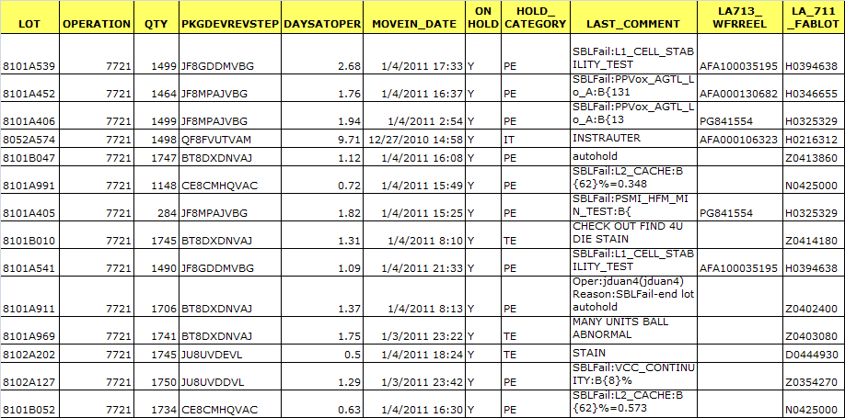
MARS
Data loaded includes lot status information such as where are lots, what lots are currently on hold, or what is the current value of a lot attribute …
WIP Lot Status v2

Slide 12
MARS
The view stores one row per lot and includes Terminated Lots. Hence it is important to filter using Terminated = N and Quantity > 0 if you only want active WIP
WIP Lot Status v2

Slide 13
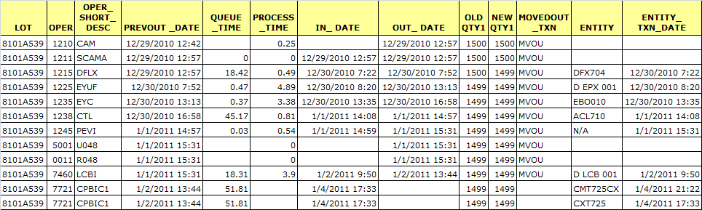
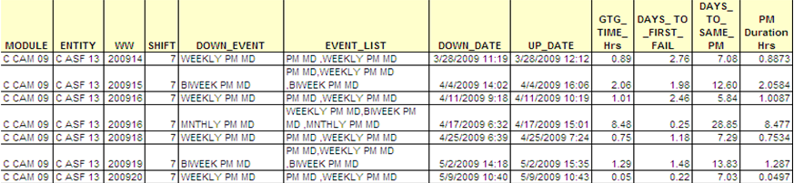
MARS
… and also lot history data such as the operations lots went through, the times lots were processed on tools and loss data
WIP Lot History v2
Entity History

Slide 14
MARS
WIP Lot History
It also loads equipment history data from WorkStream such as PM and repair history, and equipment comments.
Entity History

Slide 15
Introduction to Intel’s Manufacturing Data
Now, let’s look at ARIES which stores data loaded from Sort/Test or E-Test testers. In Test, you have the unit level bin, counter, and parametric results to name a few. This data is also rolled up to the testing session (summary) level as well as the lot level. Note that XEUS stores Sort or E-Test data for Fab sites running Fab process 1272 or higher.
Canned Applications
Scripting / Statistics
Ad-hoc
EATS
Catalyst
Crystal
Ball
CATTS
MKC
Scripting (VA, ScriptHost)
& Statistical Tools
(JMP, SAS, Excel)
Discovery
SQLPathFinder
Other Tools
SQL
Other. E.g., TCA
AEPT, EPROMS,
ASPIRE, SPEED
ATRMS, ULT…
MARS
ARIES
or
XEUS
OASys
20m
E.g.,
Equipment,
MT
WorkStream
E-Test &
Sort/Class
Testers
SPC

Slide 16
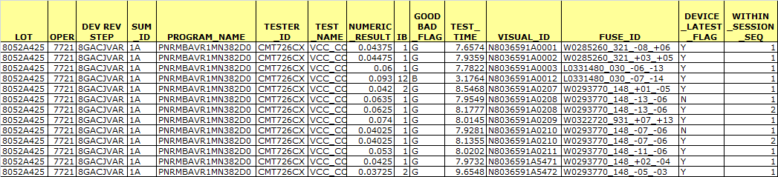
ARIES - Test
Here, you're looking at Test results for individual units, & whether the units were good or bad. ARIES rolls up this data to the testing session level (1A, 1B,…) as well the lot level. ARIES also provide traceability to the Fab lot/wafer/X/Y for Sort to Class correlations. ARIES in Fab stores die level bin, counter & parametric results and rolls up that data to the the wafer & lot level.
Sort or Test Dice or Unit Results

Slide 17
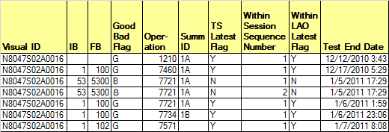
ARIES - Test
There are important flags that tell you whether a result is the latest for a unit. The results below show testing for a unit over time. At operation 7721, the unit is re-tested 3 times as 1A.
Testing Session latest flag is set to Y for the latest test within a summary at an operation.
Within Session Sequence Number shows test order within a summary
Within LAO Latest Flag denote the last test result for the unit at an operation. E.g., at 7721.
Class Unit Level Data – Retesting (Sort or Test Dice or Unit Results)

Slide 18
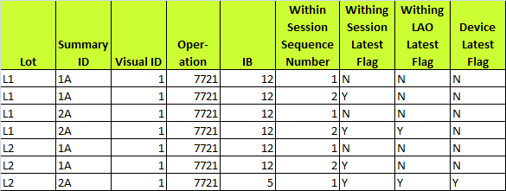
ARIES - Test
Another key column is Device Latest Flag. This is set to Y for the latest result for a test regardless of the operation. A fictitious example below summarizes these key flags.
A unit is re-tested on 1A at 7721 and then 2A. The unit is then tested again under another lot at the same operation (just for illustration purposes). The various flags are set below. Within LAO latest flag shows the last result for a lot at the operation. Within Session Latest flag shows the latest result for a lot and summary. Device Latest flag shows the latest result.
Class Unit Level Data – Retesting (Sort or Test Dice or Unit Results)

Slide 19
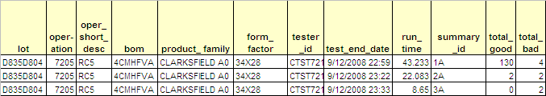
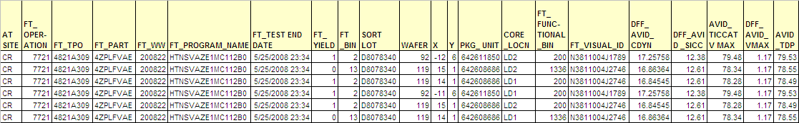
ARIES - Test
Here is an example of Test data rolled up to the testing session level (e.g., 1A, 2A, 1B).
Test Summary Data
Test to Sort Mapping Data for MCP

Slide 20
ARIES - Test
…and here is an example of ARIES query results for both class unit level bin & parametric data & Sort die level bin & parametric data..
Test Summary Data
Test to Sort Mapping Data for MCP

Slide 21
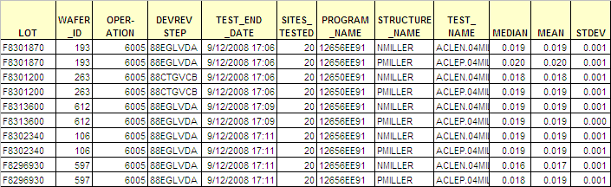
ARIES – E-Test
ARIES in Fab also stores E-Test (Electrical Test) results. Here you are looking at E-Test data rolled up to the wafer level.
E-Test Wafer Level Results

Slide 22
Introduction to Intel’s Manufacturing Data
Canned Applications
Scripting / Statistics
Ad-hoc
Next, we will review the OASys database which, in A/T, captures SPC data.
EATS
Catalyst
Crystal
Ball
CATTS
MKC
Scripting (VA, ScriptHost)
& Statistical Tools
(JMP, SAS, Excel)
Discovery
SQLPathFinder
Other Tools
SQL
Other. E.g., TCA
AEPT, EPROMS,
ASPIRE, SPEED
ATRMS, ULT…
MARS
ARIES
or
XEUS
OASys
15m
E.g.,
Equipment,
MT
WorkStream
E-Test &
Sort/Class
Testers
SPC

Slide 23
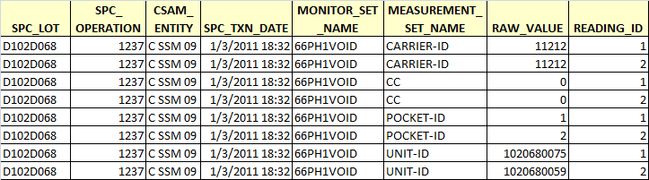
OASys - SPC
Here is an example of SPC raw data collected at CSAM metrology. In SPC, both the raw data and the chart summary data are loaded.
SPC Raw Data

Slide 24
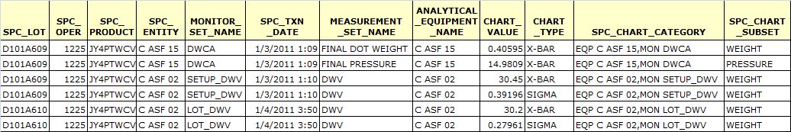
OASys - SPC
Here is an example of SPC Chart Summary data (setup and lot data) collected at Epoxy Under fill
SPC Chart Summary Data

Slide 25
Introduction to Intel’s Manufacturing Data
Canned Applications
Scripting / Statistics
Ad-hoc
Finally, there are Other databases such as TCA which stores unit level traceability data, AEPT which stores raw data to compute equipment performance, ASPIRE (ATTD only) which stores lot status and lot history data for new product introductions, and more
EATS
Catalyst
Crystal
Ball
CATTS
MKC
Scripting (VA, ScriptHost)
& Statistical Tools
(JMP, SAS, Excel)
Discovery
SQLPathFinder
Other Tools
SQL
Other. E.g., TCA
AEPT, EPROMS,
ASPIRE, SPEED
ATRMS, ULT…
MARS
ARIES
or
XEUS
OASys
E.g.,
Equipment,
MT
WorkStream
E-Test &
Sort/Class
Testers
SPC

Slide 26
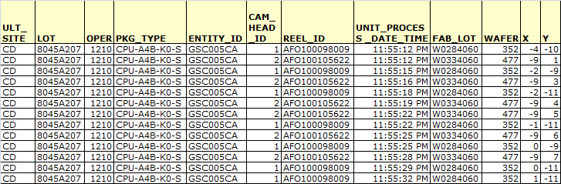
Other - TCA
TCA, for example, stores unit level traceability data.
TCA Data

Slide 27
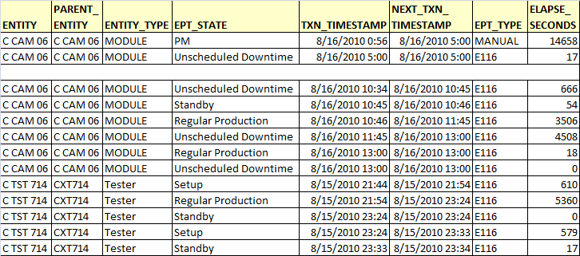
Other - AEPT
AEPT stores equipment state change information which can be used to compute equipment performance indicators such as availability and utilization.
AEPT Data

Slide 28
Introduction to Intel’s Manufacturing Data
How up to date these database systems are is reflected by the latency numbers shown in the diagram. E.g., MARS receives data within 15 minutes of it being updated in WorkStream, as does OASys from the online SPC system. Sort/Class and E-Test data are loaded within 20 minutes of a data completing testing.
Canned Applications
Canned Applications
Scripting / Statistics
Ad-hoc
EATS
Catalyst
Crystal
Ball
CATTS
MKC
Scripting (VA, ScriptHost)
& Statistical Tools
(JMP, SAS, Excel)
Discovery
SQLPathFinder
Other Tools
SQL
Other. E.g., TCA
AEPT, EPROMS,
ASPIRE, SPEED
ATRMS, ULT…
MARS
ARIES
or
XEUS
OASys
15m
20m
15m
E.g.,
Equipment,
MT
WorkStream
E-Test &
Sort/Class
Testers
SPC

Slide 29
Important A/T Views
DB | Source | Views | Description
MARS | Work-Stream | WIP_Lot_History_v2 | Lot operation-entity history (e.g., compute cycle time, line yield and losses). Also stores lot attributes , loss history, transaction history (e.g., when lots went on hold and for how long), comments, Engineering Data Collection parameter history and more
 |  | WIP_Lot_Status_v2 | Status of lots (e.g., lots at an operation or on hold)
 |  | Entity_History | Get events that occurred to an entity (e.g., run a lot, PM, repair)
ARIES | Metrol-ogy | AT_Metrology ULT_Data | Metrology data for a lot at an operation Unit Level Traceability Data
 | Test | Sort_or_Test_Lot_Rollup Sort_or_Test_Wafer_or_ Session_Rollup Sort_or_Test_Dice_or_ Unit_Results Test_Burnin | Test bin & results rolled up to lot level Test bin & results rolled up to session level (1A) Test unit level bin, counter, parametric data Test unit level data with other Burn in data
OASys | SPC++ | SPC_Chart_or_Raw | SPC chart summary or raw readings
 | RFC | AT_RFC_Master | Response Flow Checklist/Trigger Data
Other | SPEED AEPT | Speed_AT_Status AEPT_Alarm_Data | MRB/DRB data recorded in SPEED Tool alarms

Slide 30
Final Quiz!
Following are a few questions on where engineering data is stored. You are allowed several chances to answer a question correctly. So relax and have fun! ☺

Slide 31
Question 1
If you had a low yielding lot and wanted to see the WorkStream lot transaction history to determine if there was any unusual activity, what database would you access?
Question 1 – Multiple Choice
What database stores the WorkStream or MES300 lot transaction history?
MARS
ARIES
OASys
Other. E.g., AEPT

Slide 32
Question 2a
Say you wanted to pull the dates & times product went through a CAM tool as well as the lot queue time, & combine that with the Class Yield and Bin Split at 7721 (PBIC).
Question 2a – Multiple Choice
What database stores the dates & times product went through a tool as well as the queue time?
MARS
ARIES
OASys
Other. E.g., AEPT

Slide 33
Question 2b
Say you wanted to pull the dates & times product went through a CAM tool as well as the lot queue time, & combine that with the Class Yield and Bin Split at 7721 (PBIC).
Question 2b – Multiple Choice
What database stores Class yield, and bin split at Post Burn-In Check?
MARS
ARIES
OASys
Other. E.g., AEPT

Slide 34
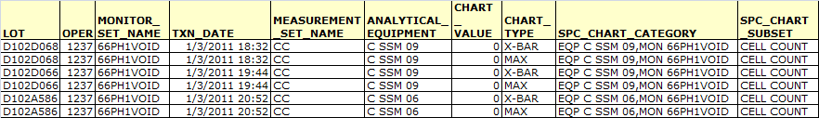
Question 3
Question 3: Where is the above data from?
MARS
ARIES
OASys
Other. E.g., AEPT

Slide 35
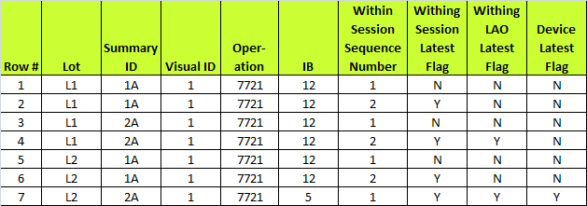
Question 4
Consider the fictitious Test unit level data collection below.
Which row shows the last result for the unit? Which flag denotes this?
Which row shows the last result for the 1A summary for lot L2? Which flag denotes this?
Which row shows the last result for lot L1 at operation 7721? Which flag denotes this?
Click Next for answers

Slide 36
Question 4 - Answers
Consider the fictitious Test unit level data collection below.
Which row shows the last result for the unit? Which flag denotes this? Row 7 & Device_Latest_Flag
Which row shows the last result for the 1A summary for lot L2? Which flag denotes this? Row 6 & Within Session latest Flag
Which row shows the last result for lot L1 at operation 7721? Which flag denotes this? Row 4 & Within LAO Latest Flag
c
b
a

Slide 37
Question 5
Question 5: Where is the above data from?
MARS
ARIES
OASys
Other. E.g., AEPT

Slide 38
That concludes the presentation
on Intel’s Manufacturing Data

